Slide 1
Basic Auctions
INFO 4220 – Networks II: Market Design
Based on Haeringer Ch. 2

Slide 2
Auctions
What is an auction?
It is a type of market mechanism that uses prices to determine allocations
Also, a price discovery mechanism
When are they needed/used?
Seller/buyers don’t know what the right price should be
There is scarcity (rare paintings)
Quality/quantity of the goods traded changes very frequently (fish, flowers, used cars, etc.)

Slide 3

When there is scarcity

Slide 4
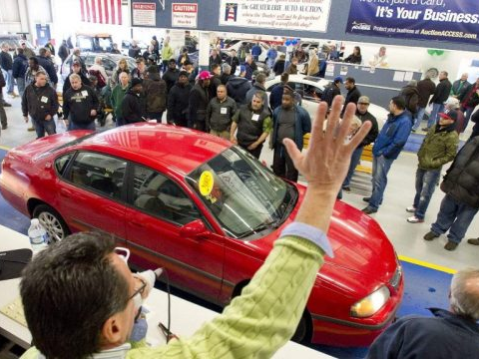
When quality of the goods change frequently

Slide 5
Definition of an auction
An auction is defined by:
Bidding format rules: What is contained in bids: They can be price only, multi-attribute, price and quantity, or quantity only
Bidding process rules: How bids are placed: Closing/timing rules, available information, rules for bid improvements/counter-bids, closing conditions
Price and allocation rules: How outcome is determined: Final price(s) and quantities, winning bidders

Slide 6
Valuations
Each bidder has a value or valuation: Highest price they are willing to pay
The valuation may depend on the valuation by others:
  If it doesn’t: Private value
  If it depends: Common value
In real life, buyers’ valuations are a mix of the two:
  Interdependent value auctions: Private value component + common value component (common to all bidders)

Slide 7
Modelling Valuations
In auction models, valuations are usually modeled as follows:
Each bidder receives a signal about their valuation
If bidders’ signals are independent from each other, and each bidder’s valuation only depends on her signal, then we have a private value model
  Often also assume that the signal is precise (no noise)
If bidders’ signals are correlated, we have the interdependent or common value model
  Usually signal is noisy (bidders don’t get the same signal), but true valuation is the same
NOTE: We will focus on private value environments where buyers know their valuations (signal not noisy)

Slide 8

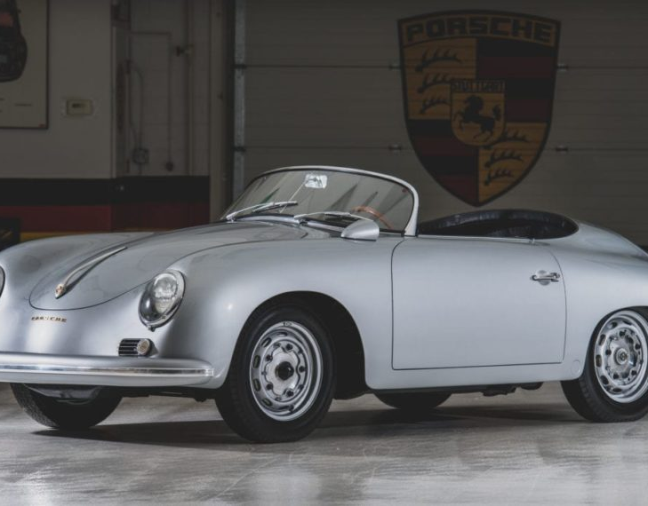
Assuming you are auctioning a car like this in good shape: More likely to follow the private value model:
Not much uncertainty about what the car is or does
Its value comes from being a reliable mean of transportation from point A to point B
Modeled as independent “signals”
Assuming you are auctioning a car like this: More likely to follow the common value model:
Its value comes from being a collector item
How other people bid gives information on the value of the item
Modeled as correlated “signals”

Slide 9
Bidding behaviors and payoffs
Bidders not always bid their true valuations
  If they do, we call it sincere/truthful bidding
  Whether bidders bid their true valuations or not depends on the auction type
The payoff of an auction is:
  If you win: Payoff = valuation – price paid
  If you lose: Payoff = 0
  We assume that if the price paid = valuation, you prefer to win rather than to lose

Slide 10
Types of Auctions
Auctions typically differ on how bids are placed
  Simultaneous: Every bidder submits their bid at the same time (normal form game)
  Sequential: Bids are entered sequentially, others can observe bids (extensive form game)
How the price is determined:
  Second-price auctions: Bidder pays the bid of the second highest bidder
  First-price auction: Bidders pay their bid
  And many other formats

Slide 11
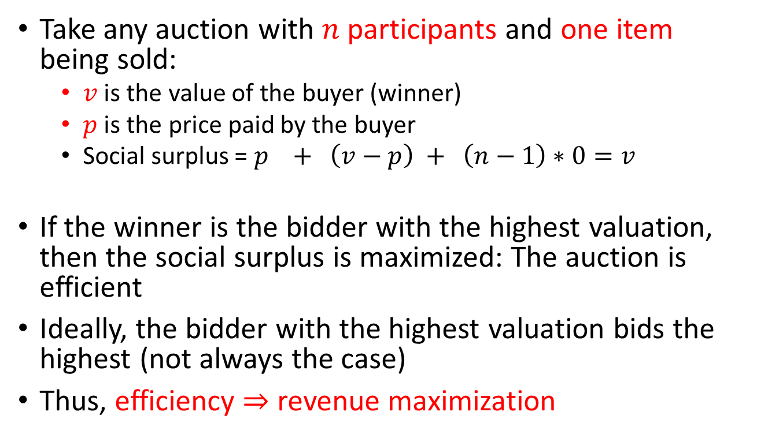
Efficiency
Take any auction with $n$ participants and one item being sold:
  $v$ is the value of the buyer (winner)
  $p$ is the price paid by the buyer
  Social surplus = $p + \left(v−p\right) + \left(n−1\right)∗0=v$
If the winner is the bidder with the highest valuation, then the social surplus is maximized: The auction is efficient
Ideally, the bidder with the highest valuation bids the highest (not always the case)
Thus, efficiency $⇒$ revenue maximization
Seller’s surplus
Winner’s surplus
Losers’ surplus

Slide 12
Ascending Auctions
(English Outcry Auction)
The price starts low and goes up (gradually) until a winner is declared (or the auction cancelled)
There are different versions depending on who can announce the prices. Two opposite cases:
Only bidders announce prices (English outcry auction):
  Jump bids usually allowed
  Auctioneer may set a minimum increment between two bids
  Ends when no further bid (or time limit reached)
  Who bids first matters: Two bidders cannot announce at the same time the same bid
  Winner: Highest bidder. Price: highest announced price by winner

Slide 13
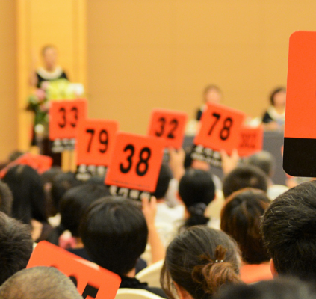
English Auction
Who bids US$100,000?

Slide 14
English Auctions
Only the auctioneer announces prices (English auction):
  The auctioneer proposes a price, the bidders just say if they accept it or not. Two options:
    Just need one bidder accepting to go to the next price
    All active bidders say whether they accept the price (those who don’t accept the announce price become inactive and cannot rejoin)
  Ends when there is only one bidder left
    If there is a tie (all remaining bidders stop at the same time), random draw determines the winner
  Winner: Last remaining bidder. Price: Last price announced by the auctioneer

Slide 15
Japanese Button Auction
(another type of English Auction)
A price is displayed, with automatic increments
Bidders push a button on a remote control. Whoever releases the button becomes inactive
Winner: Last bidder pushing the button (random draw if it is a tie). Price: Last price displayed
Ticking Price:
In an English Auction, the ticking price is the amount by which the price has to go up
In an English Outcry Auction, there could also be a ticking rule: Minimum bid increment (Think eBay)

Slide 16
Truthful bidding
Proposition:
In the English Auction, truthful bidding is a dominant strategy (i.e. The English Auction is strategyproof)
What does truthful bidding means? Recall:
A strategy describes for any possible bidding history (who bids, how much, when, etc.) if a player bids and, if so, how much
A strategy is dominant if it outperforms any other strategy for any possible history
Truthful bidding means:
Keep button pressed until price reaches my valuation. Stop pressing as soon as the price is above my valuation.

Slide 17
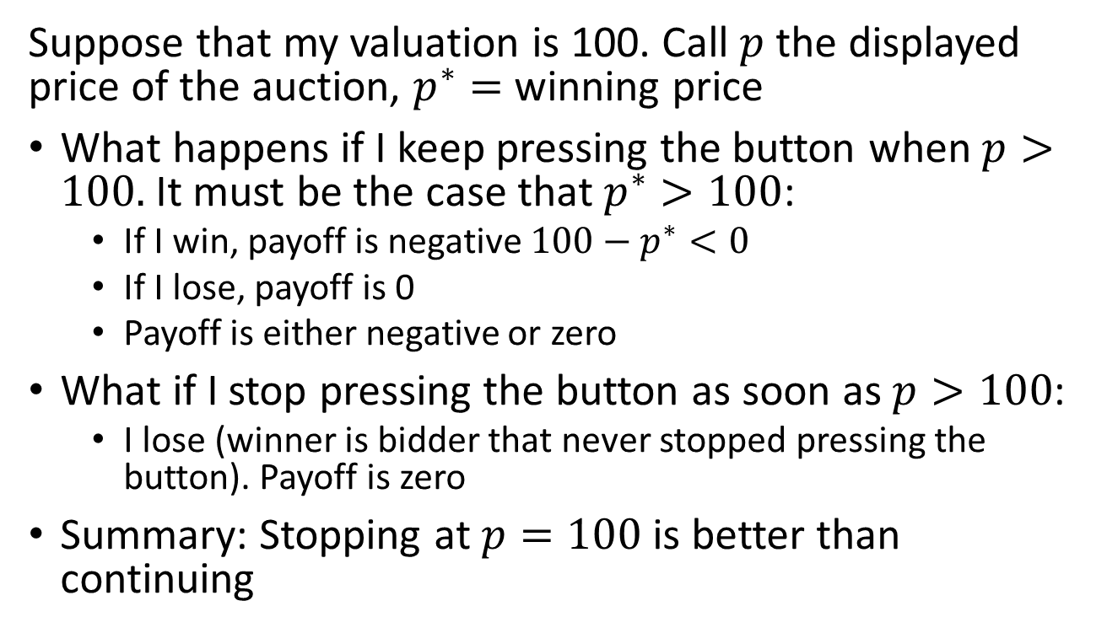
Proof
Suppose that my valuation is 100. Call $p$ the displayed price of the auction, $p^{∗}=$ winning price
What happens if I keep pressing the button when $p>100.$ It must be the case that $p^{∗}>100$:
  If I win, payoff is negative $100−p^{∗}<0$
  If I lose, payoff is 0
  Payoff is either negative or zero
What if I stop pressing the button as soon as $p>100$:
  I lose (winner is bidder that never stopped pressing the button). Payoff is zero
Summary: Stopping at $p=100$ is better than continuing

Slide 18
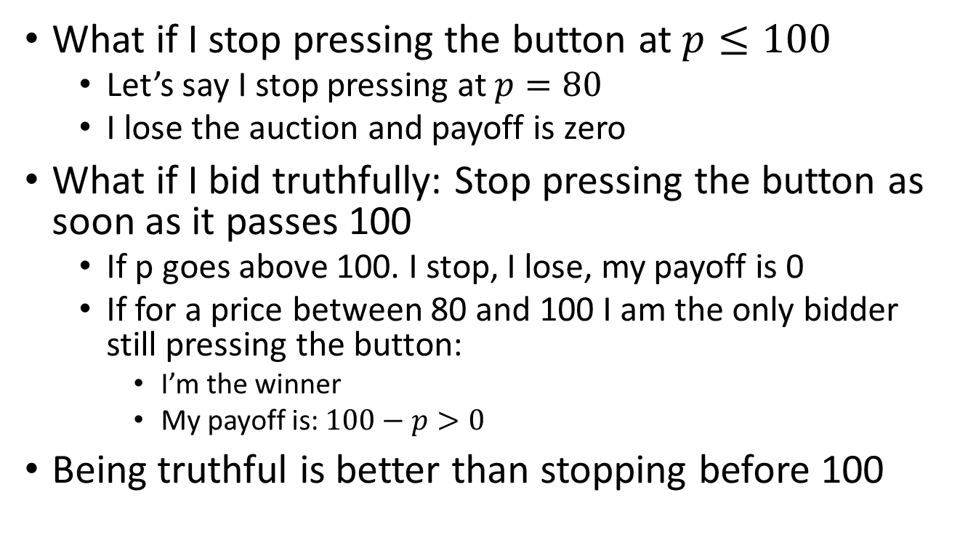
Proof
What if I stop pressing the button at $p≤100$
  Let’s say I stop pressing at $p=80$
  I lose the auction and payoff is zero
What if I bid truthfully: Stop pressing the button as soon as it passes 100
  If p goes above 100. I stop, I lose, my payoff is 0
  If for a price between 80 and 100 I am the only bidder still pressing the button:
    I’m the winner
    My payoff is: $100−p>0$
Being truthful is better than stopping before 100

Slide 19
Revelation of valuations
In an English Auction, the auctioneer learns (at the end) the valuations of all bidders, except the valuation of the highest bidder
We don’t know the valuation of the highest bidder because we don’t know when he was planning to stop pushing the button
(and we don’t know they valuation of people that didn’t bid)

Slide 20
English vs English Outcry
Case 1: Suppose there is an English outcry auction with 3 bidders: Antonio, Bruno, and Camilo
Antonio’s valuation is 100. Camilo’s valuation is 49
Bruno has odd preferences. He just hates prices between 50 and 80. If a price in this range is displayed, he bids 1,000. Otherwise, he doesn’t bid
If Antonio does gradual increments of the bid, the displayed price eventually reaches 50 and then jumps to 1000
Right strategy for Antonio is to bid 81 once price reaches 49

Slide 21
English vs English Outcry
Case 2: Now there are only 2 bidders: Antonio and Camilo
Antonio’s valuation is 100. Camilo’s valuation is 49
Antonio bids gradually until 50. At that point he wins
Lesson: How Antonio should bid in the English outcry auction depends on how other bidders bid.

Slide 22
What is an English Auction?
All ascending auctions look similar, but they differ in the details.
Can we define an auction that captures the key elements of an ascending auction?
  i.e. that is not subject to little details and weird behaviors like Bruno’s
The ascending auction implicitly assumes:
  All bidders are participating at the same time
  It make take some time to run the auction
Can we define an auction that “mimics” the English auction and does not require bidders to meet and is instantaneous?

Slide 23
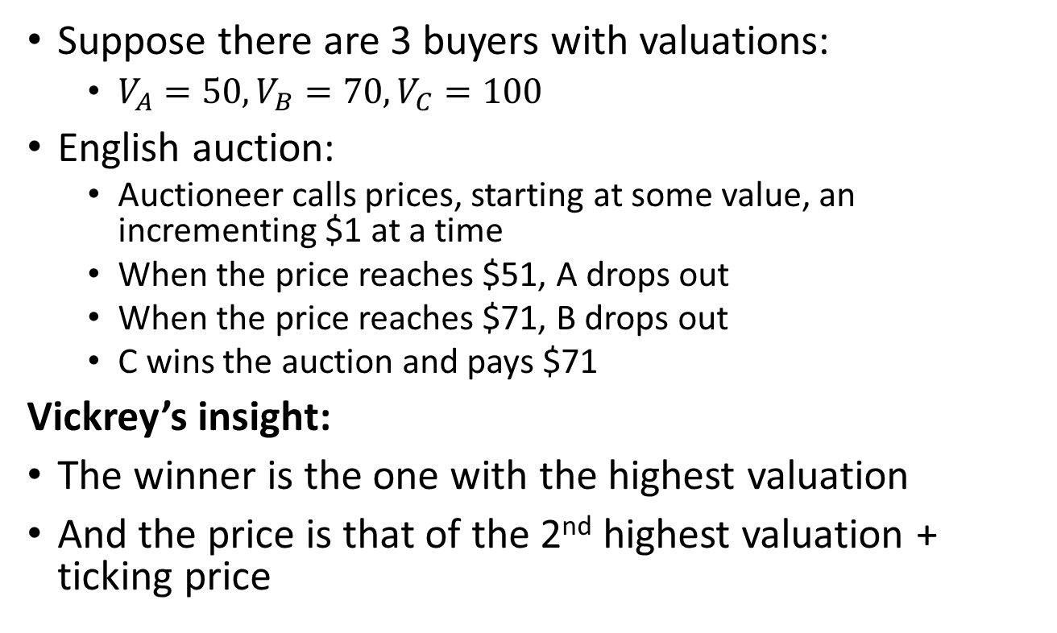
William Vickrey’s Auction
Suppose there are 3 buyers with valuations:
  $V_{A}=50, V_{B}=70, V_{C}=100$
English auction:
  Auctioneer calls prices, starting at some value, an incrementing $1 at a time
  When the price reaches $51, A drops out
  When the price reaches $71, B drops out
  C wins the auction and pays $71
Vickrey’s insight:
The winner is the one with the highest valuation
And the price is that of the 2nd highest valuation + ticking price

Slide 24
William Vickrey’s Auction
The Vickrey auction is a simultaneous, 2nd price auction (also called 2nd price sealed bid auction):
  Buyers submit a sealed-bid
  The winner is the one with the highest bid
  The winner pays the 2nd highest price
  (The ticking price disappears because there are no dynamics)
Proposition:
In the Vickrey auction, truthful bidding is a dominant strategy (i.e. it is strategyproof)

Slide 25
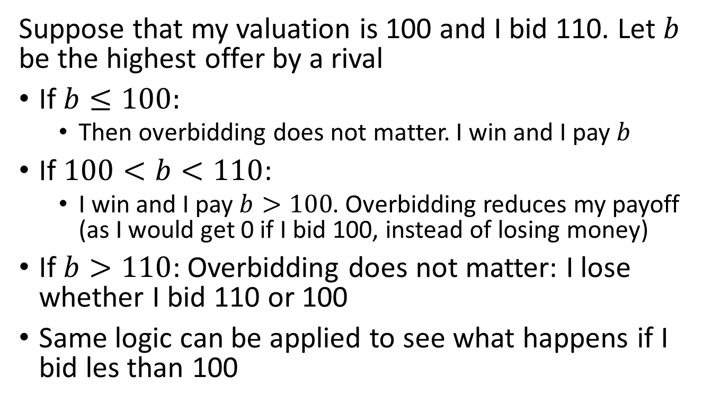
Proof
Suppose that my valuation is 100 and I bid 110. Let $b$ be the highest offer by a rival
If $b≤100:$
  Then overbidding does not matter. I win and I pay $b$
If $100<b<110$:
  I win and I pay $b>100$. Overbidding reduces my payoff (as I would get 0 if I bid 100, instead of losing money)
If $b>110$: Overbidding does not matter: I lose whether I bid 110 or 100
Same logic can be applied to see what happens if I bid les than 100

Slide 26
English vs Vickrey
In both the English and the Vickrey auction:
Bidders use the same strategy: Bid their valuation
Outcome is the same (who wins and price)
Bidders get the same payoff
The seller gets the same revenue
(We are ignoring the ticking price, which is often the assumption when doing theoretical analysis… because it is usually small and doesn’t matter much)

Slide 27
English vs Vickrey
The English auction and Vickrey auctions are similar, but they are not exactly the same:
The Vickrey auction is a strategic (normal) form game: Bidders can never learn the bids of their opponent
The English auction is an extensive form game: Bidders may observe the bids of their opponent (when they drop out)
A strategy is more complicated in an English auction: It specifies an action (press/release button) for any possible history

Slide 28
English vs Vickrey
The bidding decisions in the English and Vickrey auctions are identical if:
Bidders are rational
Bidders know perfectly their valuations (and they don’t change)
Valuations are private
HOWEVER: In practice the presence/absence of bidders and other feature can influence bidders’ behaviors

Slide 29
Recap Second Price Auctions
Auctions:
  Market mechanism that uses prices to allocate items
  And at the same time helps discover prices
  We want auctions to allocate the item to whoever values it the most => This leads to efficiency
Second price auctions:
  English outcry auction – Sequential auction, bidders call the prices (there is a minimum increment)
  English auction – Sequential auction, auctioneer announces prices (typically at fix increases)
  Vickrey auction – Simultaneous auction. Bidders submit sealed bids. Winner is the highest bidder who pays the second highest price
  Optimal strategy is to bid your true valuation

Slide 30
First-Price Auction
In a first price auction, the winner pays their bid
The English auctions we have discussed are not first-price. They are second-price or almost second-price (i.e. winner pays 2nd highest bid)
A first-price sealed bid auction works as follows:
  Bidders submit a sealed bid
  Highest bidder wins
  Winner pays her bid

Slide 31
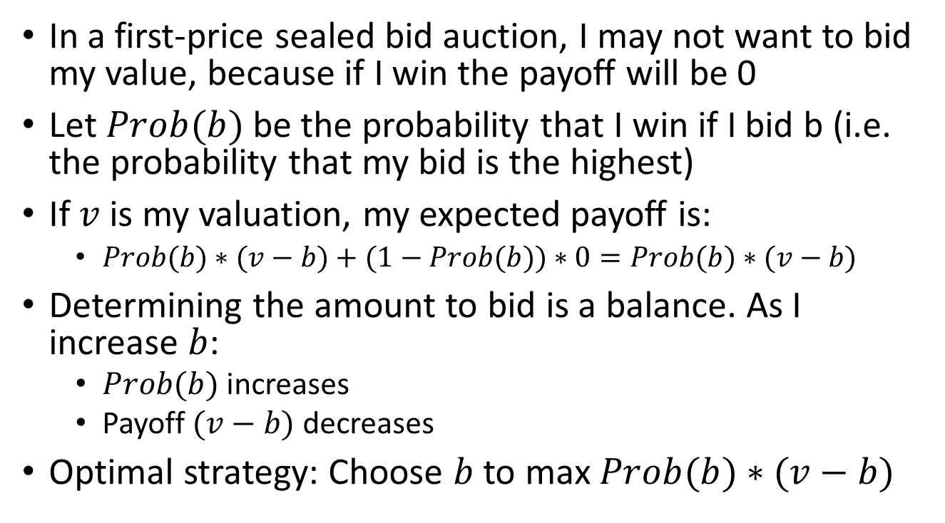
Bidding Strategy: First-price auction
In a first-price sealed bid auction, I may not want to bid my value, because if I win the payoff will be 0
Let $Prob(b)$be the probability that I win if I bid b (i.e. the probability that my bid is the highest)
If $v$ is my valuation, my expected payoff is:
  $Prob(b)∗(v−b)+(1−Prob(b))∗0=Prob(b)∗(v−b)$
Determining the amount to bid is a balance. As I increase $b$:
  $Prob(b)$increases
  Payoff $(v−b)$decreases
Optimal strategy: Choose $b$ to max $Prob(b)∗(v−b)$

Slide 32
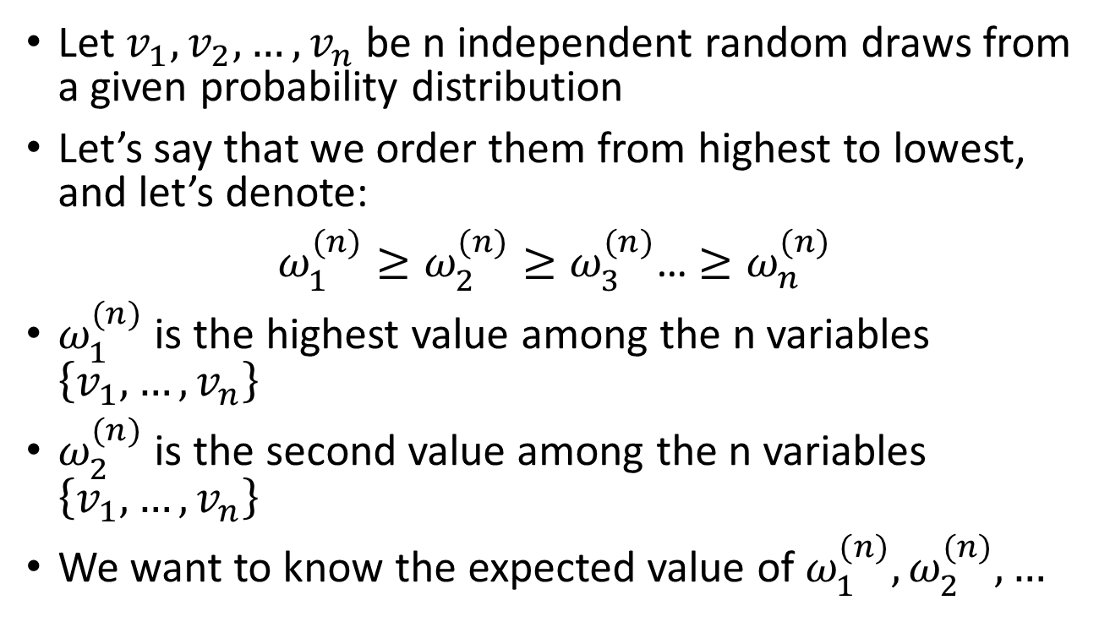
Order Statistics
Let $v_{1},v_{2},…,v_{n}$ be n independent random draws from a given probability distribution
Let’s say that we order them from highest to lowest, and let’s denote:
$ω_{1}^{(n)}≥ω_{2}^{(n)}≥ω_{3}^{(n)}$… $≥ω_{n}^{(n)}$
$ω_{1}^{(n)}$ is the highest value among the n variables $\left\{v_{1},…,v_{n}\right\}$
$ω_{2}^{(n)}$ is the second value among the n variables $\left\{v_{1},…,v_{n}\right\}$
We want to know the expected value of $ω_{1}^{(n)},ω_{2}^{(n)},…$

Slide 33
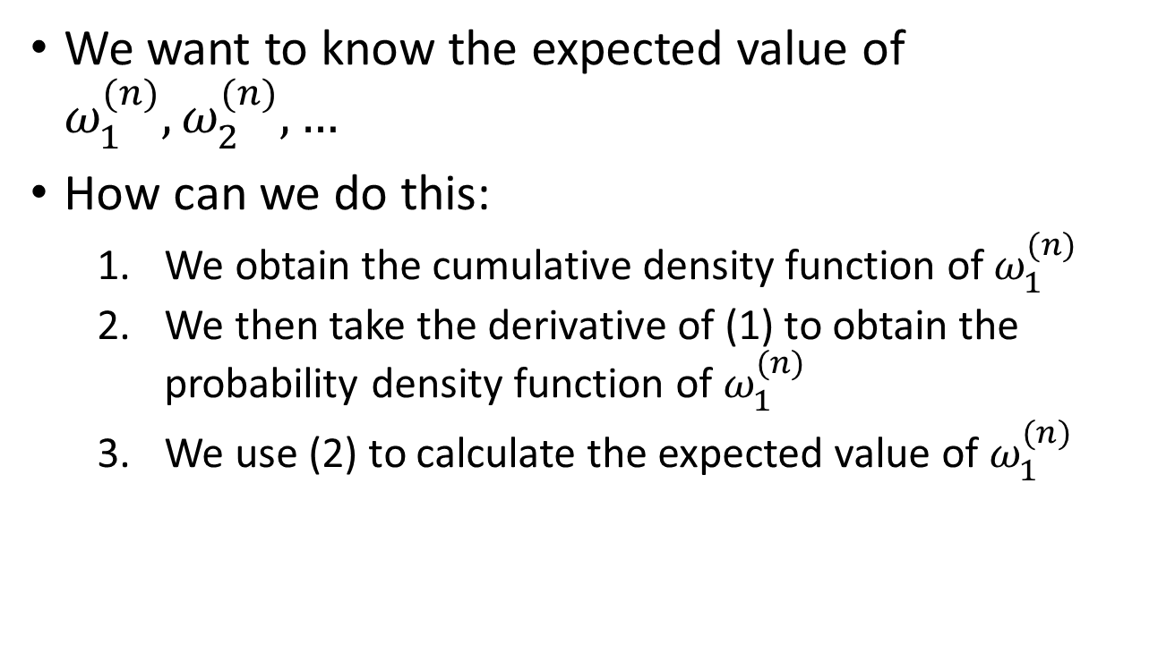
Order Statistics
We want to know the expected value of $ω_{1}^{(n)},ω_{2}^{(n)},…$
How can we do this:
  We obtain the cumulative density function of$ω_{1}^{(n)}$
  We then take the derivative of (1) to obtain the probability density function of $ω_{1}^{(n)}$
  We use (2) to calculate the expected value of $ω_{1}^{(n)}$

Slide 34
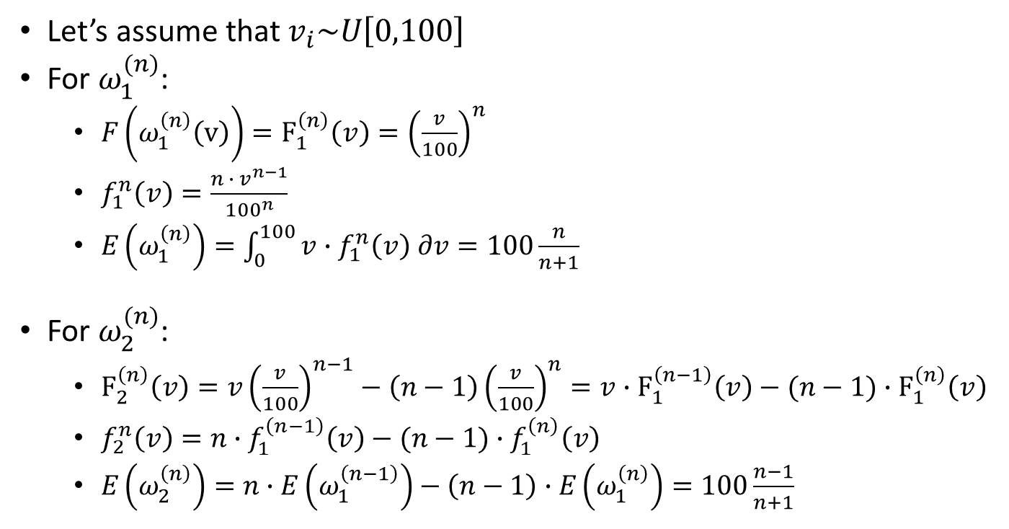
Order Statistics
Let’s assume that $v_{i}\sim U\left[0,100\right]$
For $ω_{1}^{(n)}$:
  $F\left(ω_{1}^{\left(n\right)}\left(v\right)\right)=F_{1}^{\left(n\right)}\left(v\right)={\left(\frac{v}{100}\right)}^{n}$
  $f_{1}^{n}\left(v\right)=\frac{n ∙ v^{n−1}}{{100}^{n}}$
  $E\left(ω_{1}^{\left(n\right)}\right)=\int_{0}^{100}{v∙f_{1}^{n}\left(v\right) ∂v}=100\frac{n}{n+1}$
For $ω_{2}^{(n)}$:
  $F_{2}^{\left(n\right)}\left(v\right)=v{\left(\frac{v}{100}\right)}^{n−1}−\left(n−1\right){\left(\frac{v}{100}\right)}^{n}=v∙F_{1}^{\left(n−1\right)}\left(v\right)−(n−1)∙F_{1}^{\left(n\right)}\left(v\right)$
  $f_{2}^{n}\left(v\right)=n∙f_{1}^{\left(n−1\right)}\left(v\right)−(n−1)∙f_{1}^{\left(n\right)}\left(v\right)$
  $E\left(ω_{2}^{\left(n\right)}\right)=n∙E\left(ω_{1}^{\left(n−1\right)}\right)−\left(n−1\right)∙E\left(ω_{1}^{\left(n\right)}\right)=100\frac{n−1}{n+1}$

Slide 35
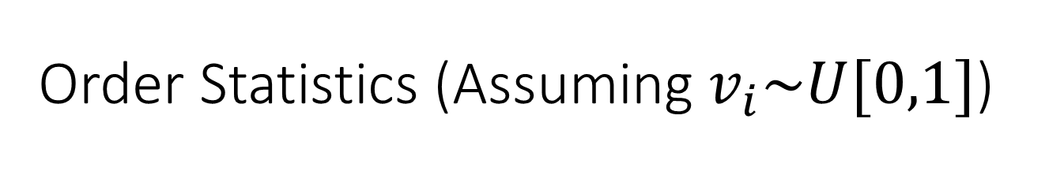
Order Statistics (Assuming $v_{i}\sim U[0,1]$)
One draw
0
1/2
1
Two draws
0
1/3
2/3
1
Three draws
0
1/4
2/4
3/4
1

Slide 36
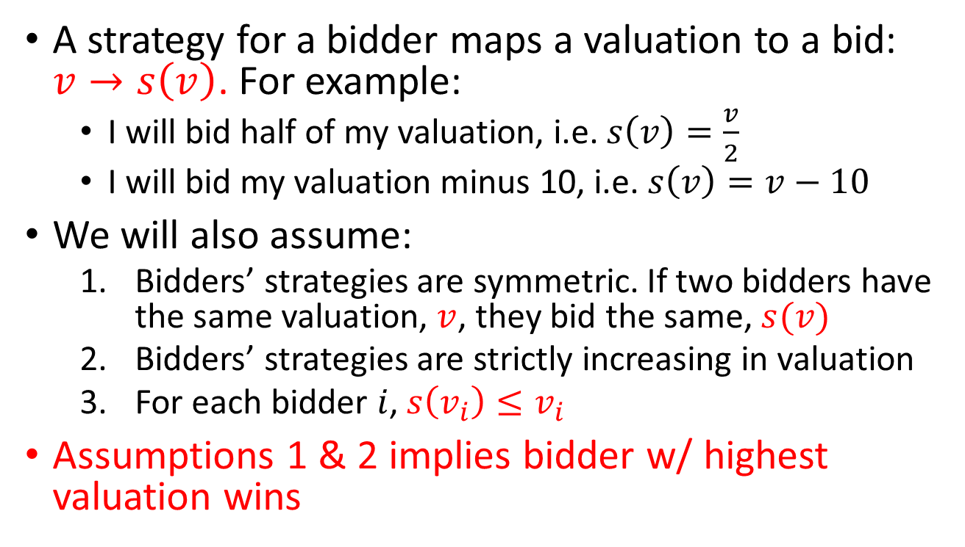
Bidding Strategy: First-price auction
A strategy for a bidder maps a valuation to a bid: $v→s\left(v\right)$. For example:
  I will bid half of my valuation, i.e. $s\left(v\right)=\frac{v}{2}$
  I will bid my valuation minus 10, i.e. $s\left(v\right)=v−10$
We will also assume:
  Bidders’ strategies are symmetric. If two bidders have the same valuation, $v$, they bid the same, $s(v)$
  Bidders’ strategies are strictly increasing in valuation
  For each bidder $i$, $s\left(v_{i}\right)≤v_{i}$
Assumptions 1 & 2 implies bidder w/ highest valuation wins

Slide 37
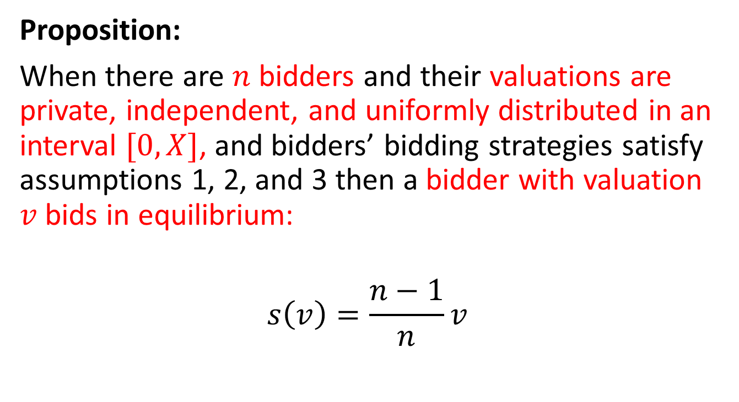
Optimal bidding in First-price auctions
Proposition:
When there are $n$ bidders and their valuations are private, independent, and uniformly distributed in an interval $[0,X]$, and bidders’ bidding strategies satisfy assumptions 1, 2, and 3 then a bidder with valuation $v$ bids in equilibrium:
$$s\left(v\right)=\frac{n−1}{n}v$$

Slide 38
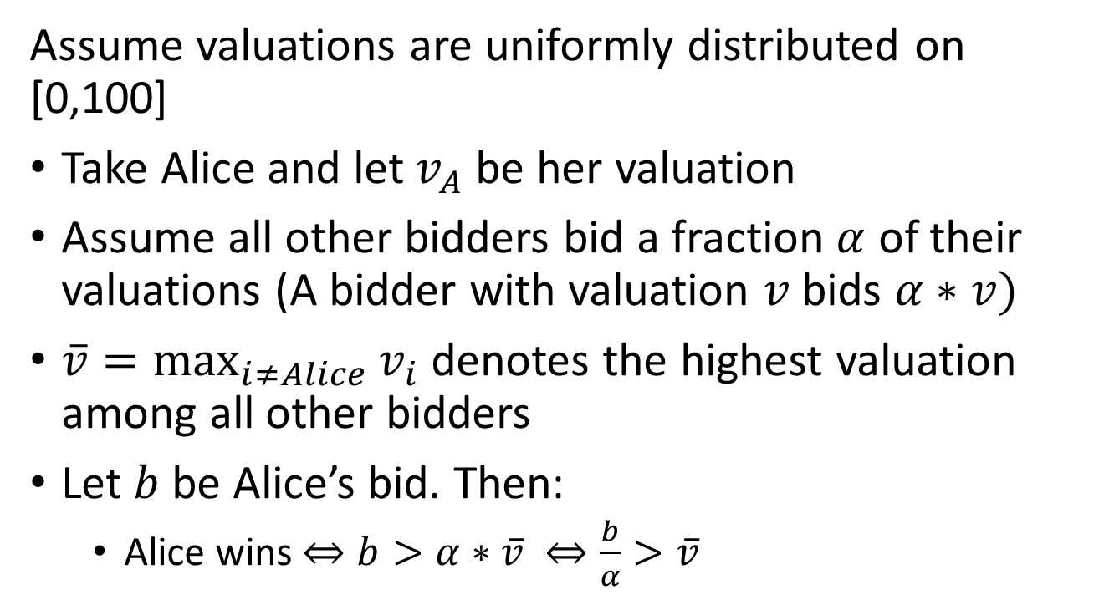
Proof
Assume valuations are uniformly distributed on [0,100]
Take Alice and let $v_{A}$ be her valuation
Assume all other bidders bid a fraction $α$ of their valuations (A bidder with valuation $v$ bids $α∗v)$
$\overline{v}=\max_{i≠Alice}{v_{i}}$denotes the highest valuation among all other bidders
Let $b$be Alice’s bid. Then:
  Alice wins $⇔b>α∗\overline{v} ⇔\frac{b}{α}>\overline{v}$

Slide 39
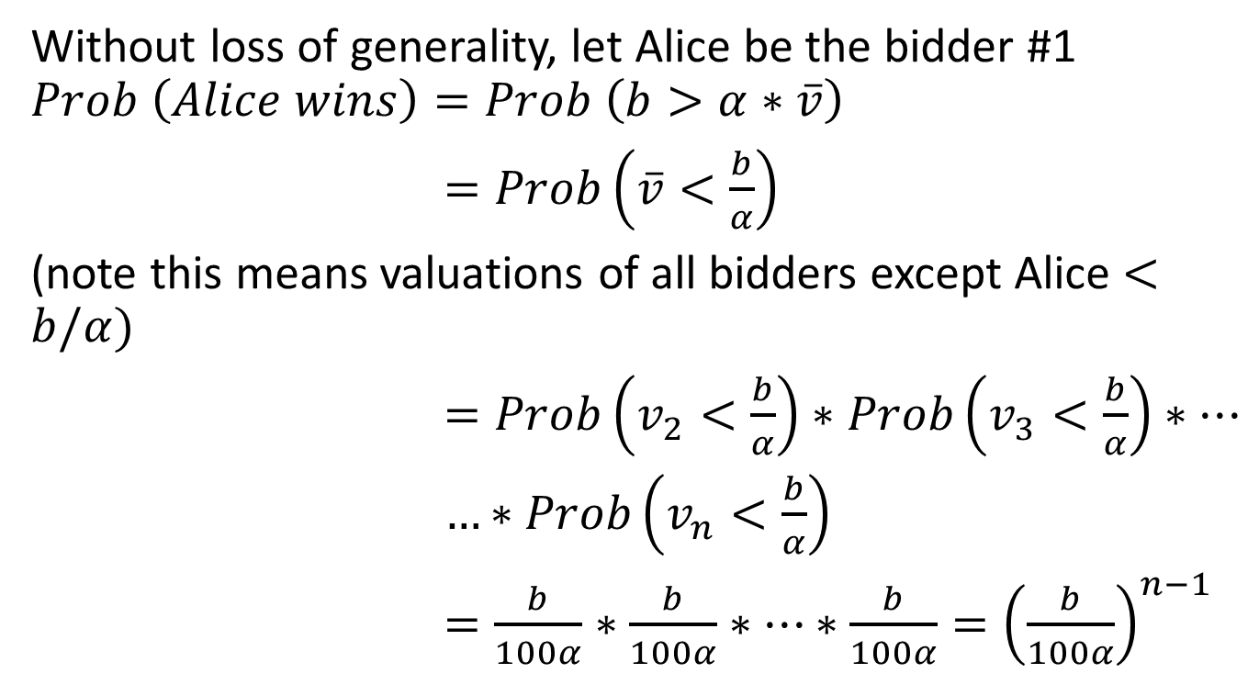
Proof
Without loss of generality, let Alice be the bidder #1
$$Prob \left(Alice wins\right)=Prob \left(b>α∗\overline{v}\right)$$
$=Prob\left(\overline{v}<\frac{b}{α}\right)$
(note this means valuations of all bidders except Alice $<b/α)$
$=Prob\left(v_{2}<\frac{b}{α}\right)∗Prob\left(v_{3}<\frac{b}{α}\right)∗…$
$…∗Prob\left(v_{n}<\frac{b}{α}\right)$
$=\frac{b}{100α}∗\frac{b}{100α}∗…∗\frac{b}{100α}={\left(\frac{b}{100α}\right)}^{n−1}$
n-1 times

Slide 40
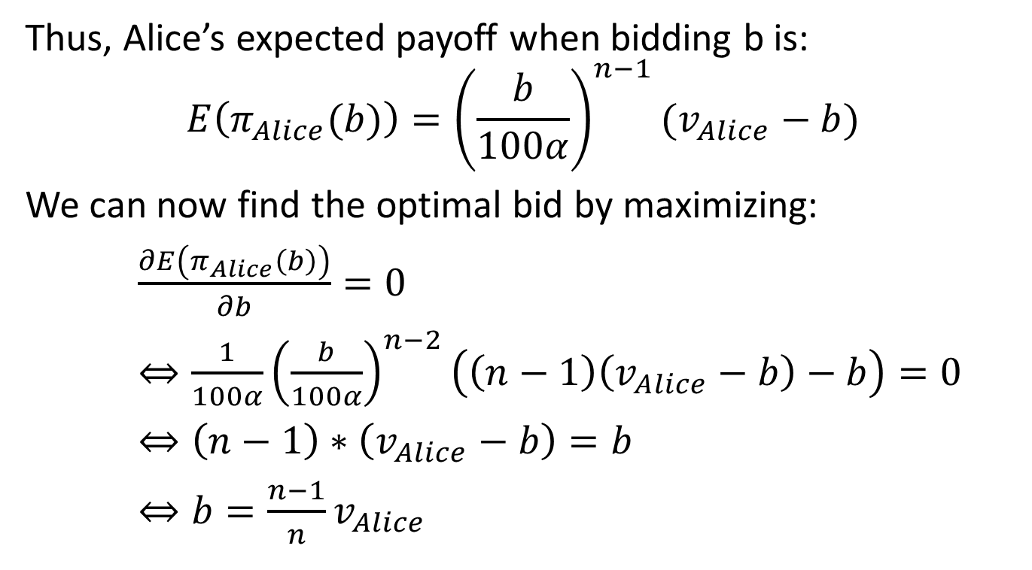
Proof
Thus, Alice’s expected payoff when bidding b is:
$$E\left(π_{Alice}(b)\right)={\left(\frac{b}{100α}\right)}^{n−1}(v_{Alice}−b)$$
We can now find the optimal bid by maximizing:
$\frac{∂E\left(π_{Alice}\left(b\right)\right)}{∂b}=0$
$⇔\frac{1}{100α}{\left(\frac{b}{100α}\right)}^{n−2}\left(\left(n−1\right)\left(v_{Alice}−b\right)−b\right)=0$
$⇔\left(n−1\right)∗\left(v_{Alice}−b\right)=b$
$⇔b=\frac{n−1}{n}v_{Alice}$

Slide 41
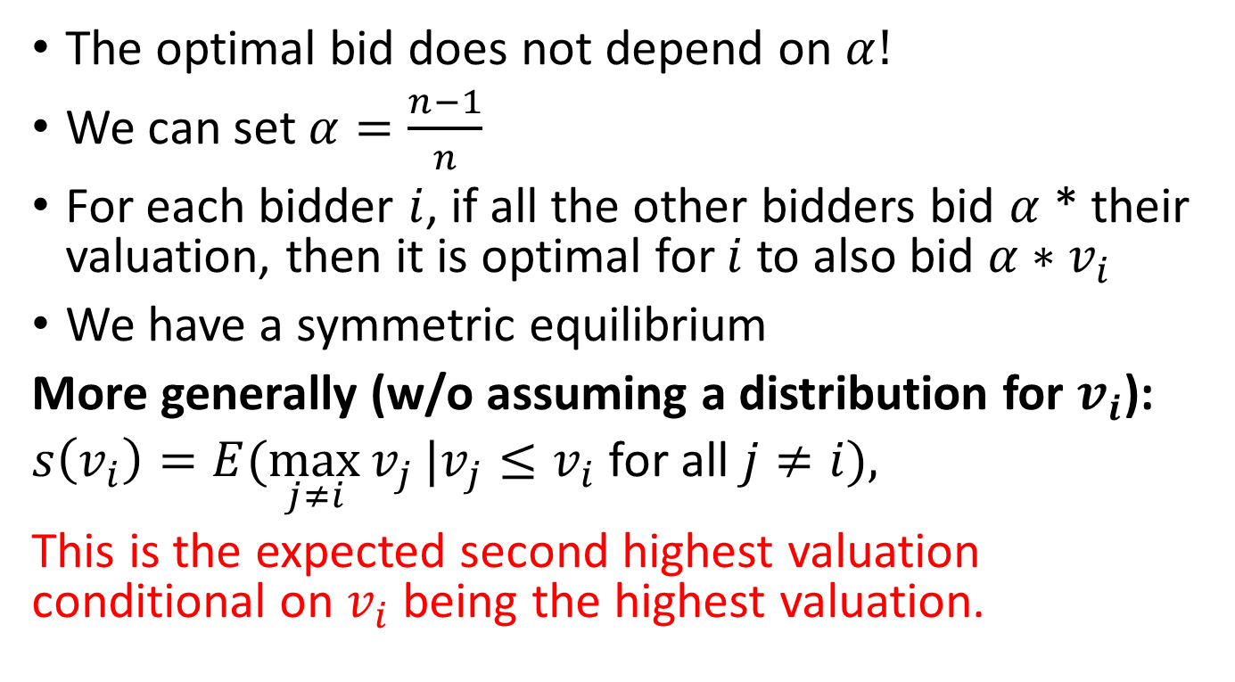
Optimal Bid
The optimal bid does not depend on $α!$
We can set $α=\frac{n−1}{n}$
For each bidder $i$, if all the other bidders bid $α$ * their valuation, then it is optimal for $i$ to also bid $α∗v_{i}$
We have a symmetric equilibrium
More generally (w/o assuming a distribution for $v_{i}$):
$s\left(v_{i}\right)=E(\max_{j≠i}{v_{j}}|v_{j}≤v_{i}$ for all $j≠i),$
This is the expected second highest valuation conditional on $v_{i}$ being the highest valuation.

Slide 42
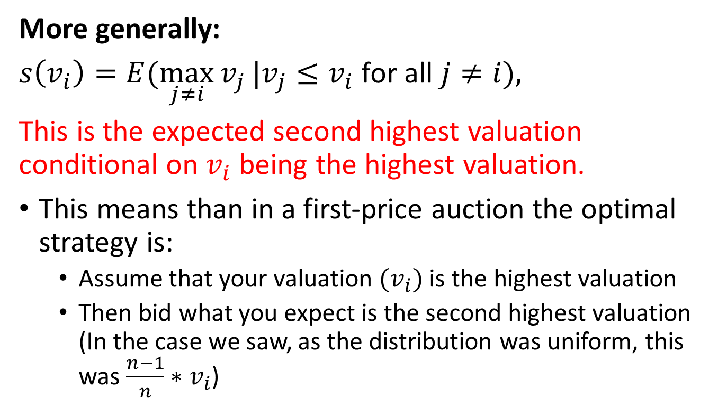
Optimal Bid First-Price Auction
More generally:
$s\left(v_{i}\right)=E(\max_{j≠i}{v_{j}}|v_{j}≤v_{i}$ for all $j≠i),$
This is the expected second highest valuation conditional on $v_{i}$ being the highest valuation.
This means than in a first-price auction the optimal strategy is:
  Assume that your valuation $(v_{i})$ is the highest valuation
  Then bid what you expect is the second highest valuation (In the case we saw, as the distribution was uniform, this was $\frac{n−1}{n}∗v_{i}$)

Slide 43
Dutch Auction
The Dutch/descending price auction is a first-price auction:
  There is a price clock: display a price that is decreasing
  The auction stops as soon as someone claims the object
  This is strategically equivalent to a first-price sealed-bid auction: Bidding one’s valuation is not a dominant strategy
Advantages of Dutch Auctions:
  Can go fast
  Can use bidders’ nervousness (so that they bid higher than their value)

Slide 44
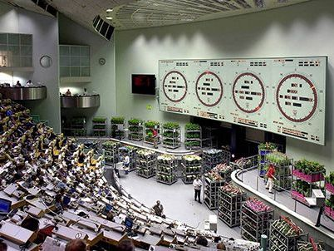
Dutch Auction
Photo: enovosty.com

Slide 45
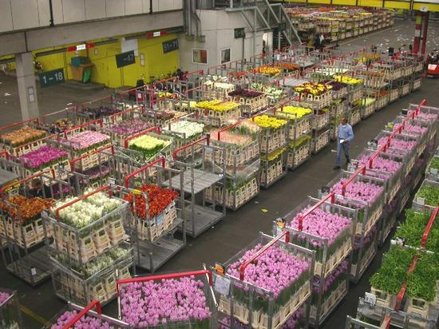
Dutch Auction
Photo: https://www.flowersmadeeasy.ie/blog/dutch-flower-auction-prices/

Slide 46
Dutch vs. First-price auction
Dutch and first price look different:
  First-price auction is a strategic form game
  Dutch auction is an extensive form game
But, in the Dutch auction a bidder cannot distinguish between two histories (paths) unless another bidder claims the object
  And in that case is already late
Strategies in both auctions are identical: A price
  Bidders use the same strategies
  Bidders obtain the same payoffs
  Sellers get the same revenue
  Thus, Dutch and First-price sealed-bid auctions are equivalent

Slide 47
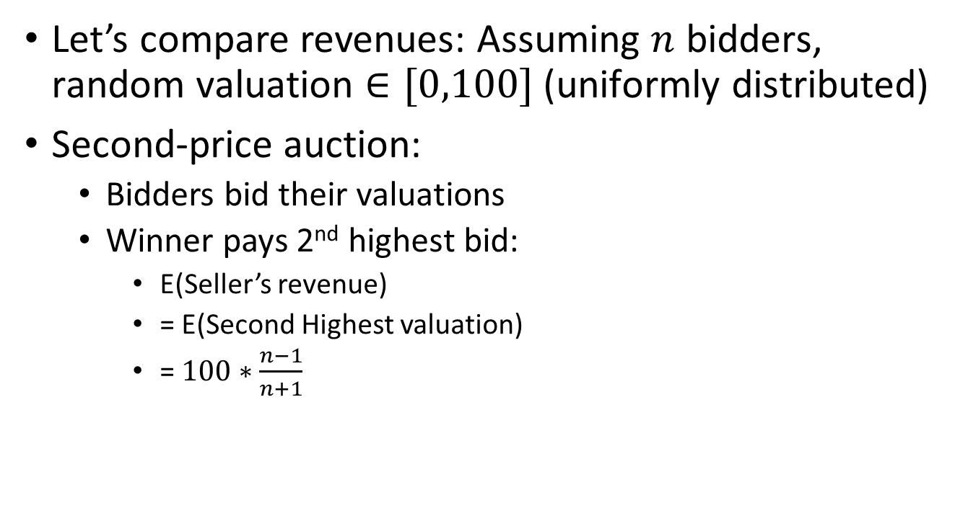
Second-price (English) vs First-price (Dutch) auctions
Let’s compare revenues: Assuming $n$ bidders, random valuation $∈[0,100]$ (uniformly distributed)
Second-price auction:
  Bidders bid their valuations
  Winner pays 2nd highest bid:
    E(Seller’s revenue)
    = E(Second Highest valuation)
    = $100∗\frac{n−1}{n+1}$

Slide 48
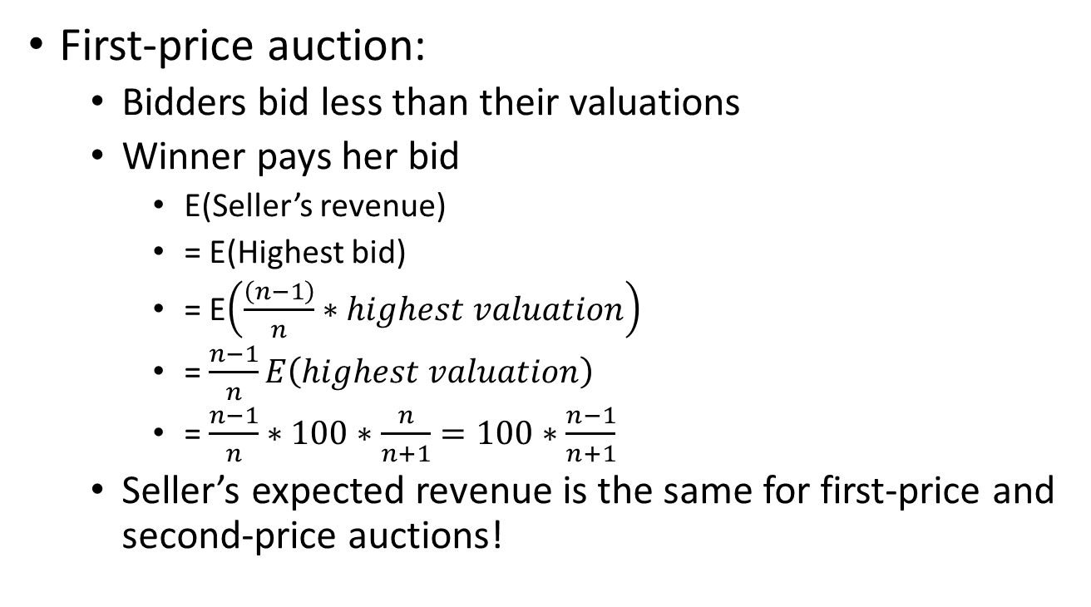
Second-price (English) vs First-price (Dutch) auctions
First-price auction:
  Bidders bid less than their valuations
  Winner pays her bid
    E(Seller’s revenue)
    = E(Highest bid)
    = E$\left(\frac{\left(n−1\right)}{n}∗highest valuation\right)$
    = $\frac{n−1}{n}E\left(highest valuation\right)$
    = $\frac{n−1}{n}∗100∗\frac{n}{n+1}=100∗\frac{n−1}{n+1}$
  Seller’s expected revenue is the same for first-price and second-price auctions!

Slide 49
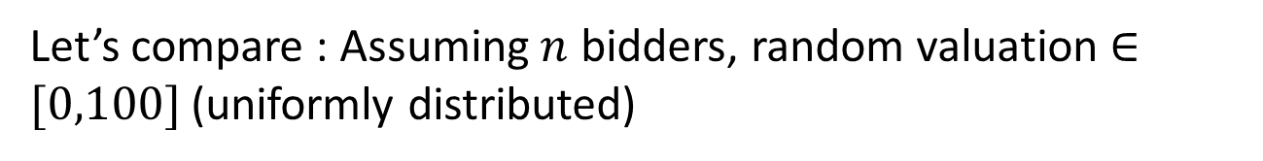
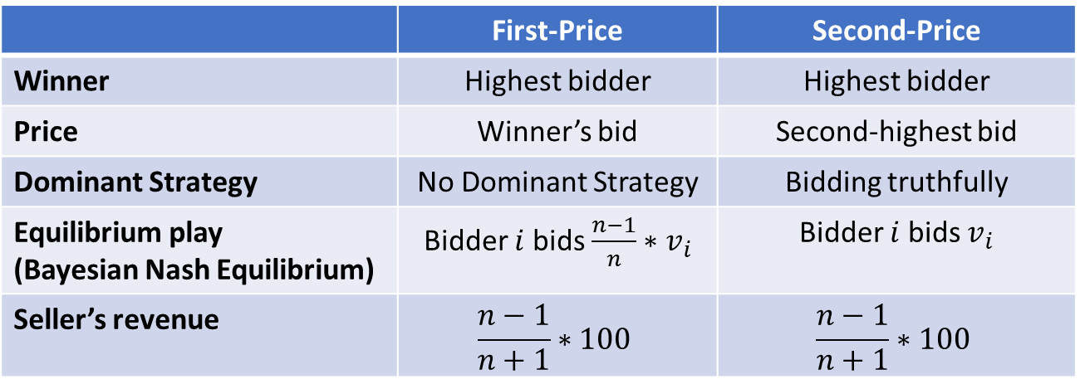
Second-price (English) vs First-price (Dutch) auctions
Let’s compare : Assuming $n$ bidders, random valuation $∈[0,100]$ (uniformly distributed)
 | First-Price | Second-Price
Winner | Highest bidder | Highest bidder
Price | Winner’s bid | Second-highest bid
Dominant Strategy | No Dominant Strategy | Bidding truthfully
Equilibrium play (Bayesian Nash Equilibrium) | Bidder $i$ bids $\frac{n−1}{n}∗v_{i}$ | Bidder $i$ bids $v_{i}$
Seller’s revenue | $$\frac{n−1}{n+1}∗100$$ | $$\frac{n−1}{n+1}∗100$$

Slide 50
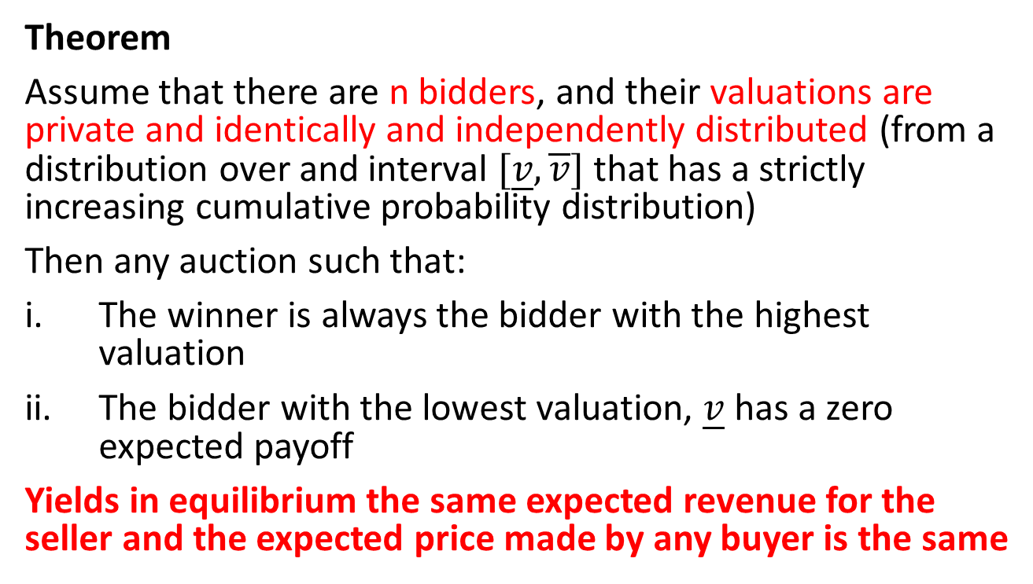
Revenue Equivalence
Theorem
Assume that there are n bidders, and their valuations are private and identically and independently distributed (from a distribution over and interval $[\underline{v},\overline{v}]$ that has a strictly increasing cumulative probability distribution)
Then any auction such that:
The winner is always the bidder with the highest valuation
The bidder with the lowest valuation, $\underline{v}$ has a zero expected payoff
Yields in equilibrium the same expected revenue for the seller and the expected price made by any buyer is the same

Slide 51
Reserve Price
In 1990, in auctions for radio spectrum in New Zealand:
Highest bid: NZ$100,000, 2nd highest bid: NZ$6
Highest bid: NZ$7 MM, 2nd highest bid: NZ$5,000
Pretty bad. Solution is adding a reserve price:
Only bids above the reserve price are considered
Guarantee a minimum revenue for the seller
Kind of like the seller placing a bid
Not risk free: If no bid meets reserve price, final revenue is 0

Slide 52
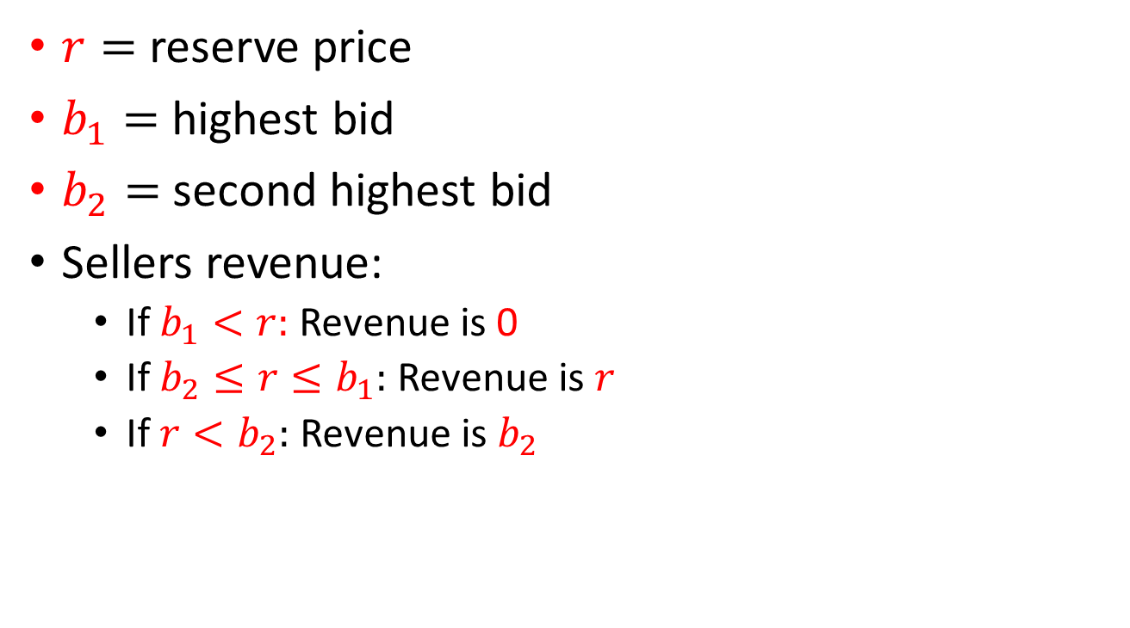
Reserve price with a Second-price auction
$r=$reserve price
$b_{1}=$highest bid
$b_{2}=$second highest bid
Sellers revenue:
  If $b_{1}<r:$ Revenue is 0
  If $b_{2}≤r≤b_{1}:$ Revenue is $r$
  If $r<b_{2}:$ Revenue is $b_{2}$

Slide 53
Optimal reserve price
We want to set the reserve price that maximized the revenue
Ideally, set r = highest valuation
There is a tradeoff with increasing the reserve price:
  Higher revenue if it sells
  Lower probability to sell

Slide 54
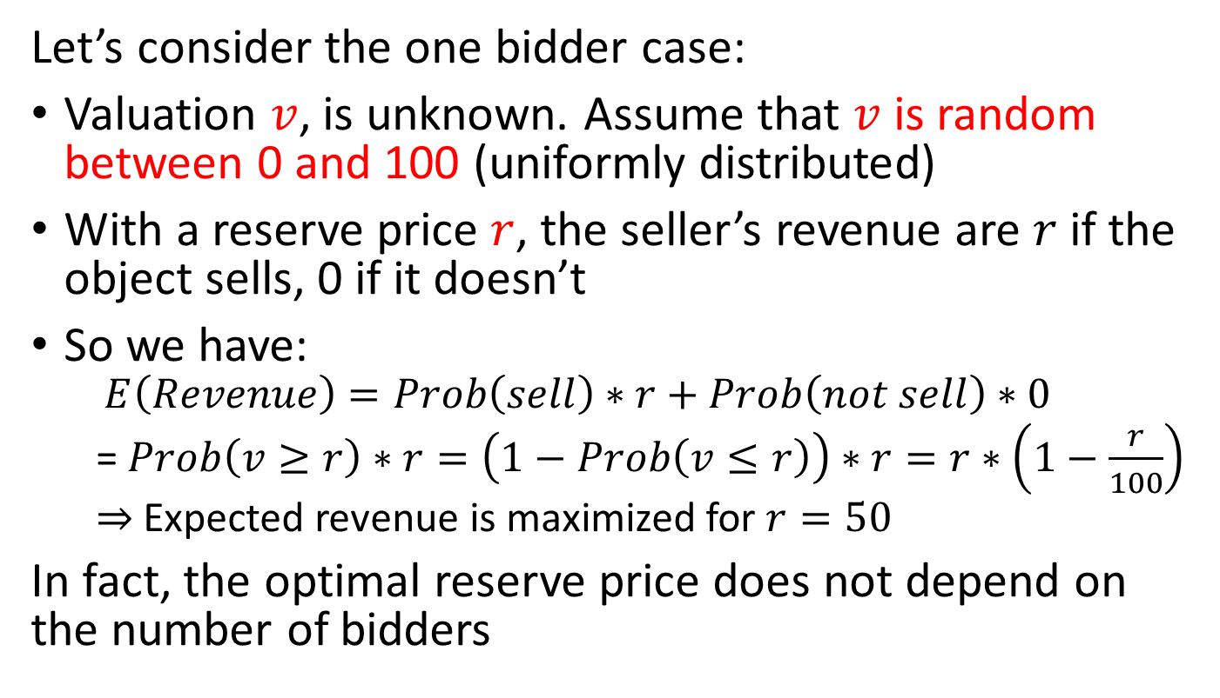
Optimal reserve price
Let’s consider the one bidder case:
Valuation $v$, is unknown. Assume that $v$ is random between 0 and 100 (uniformly distributed)
With a reserve price $r$, the seller’s revenue are $r$ if the object sells, 0 if it doesn’t
So we have:
  $$E\left(Revenue\right)=Prob\left(sell\right)∗r+Prob\left(not sell\right)∗0$$
  = $Prob\left(v≥r\right)∗r=\left(1−Prob\left(v≤r\right)\right)∗r=r∗\left(1−\frac{r}{100}\right)$
  $⇒$Expected revenue is maximized for $r=50$
In fact, the optimal reserve price does not depend on the number of bidders

Slide 55
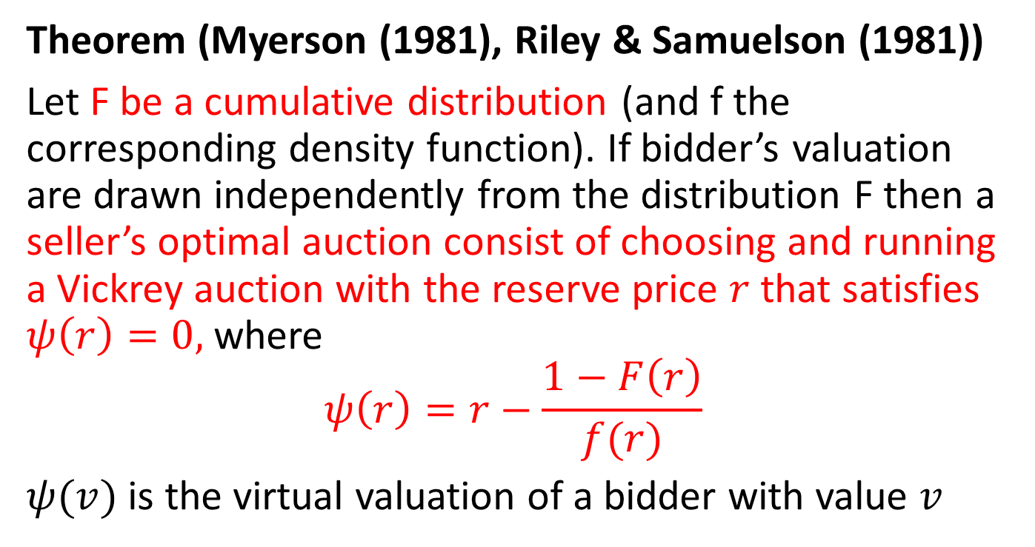
Optimal Auction
Theorem (Myerson (1981), Riley & Samuelson (1981))
Let F be a cumulative distribution (and f the corresponding density function). If bidder’s valuation are drawn independently from the distribution F then a seller’s optimal auction consist of choosing and running a Vickrey auction with the reserve price $r$that satisfies $ψ\left(r\right)=0,$where
$$ψ\left(r\right)=r−\frac{1−F\left(r\right)}{f(r)}$$
$ψ(v)$ is the virtual valuation of a bidder with value $v$

Slide 56
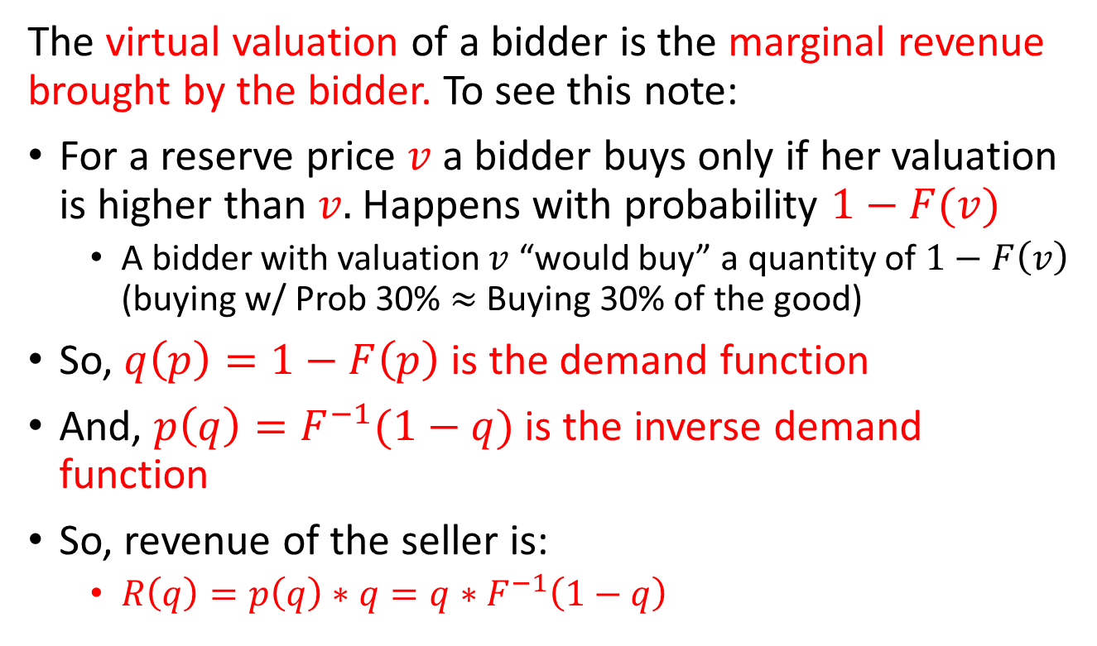
Virtual Valuation
The virtual valuation of a bidder is the marginal revenue brought by the bidder. To see this note:
For a reserve price $v$ a bidder buys only if her valuation is higher than $v.$ Happens with probability $1−F(v)$
  A bidder with valuation $v$ “would buy” a quantity of $1−F\left(v\right)$ (buying w/ Prob 30% $≈$ Buying 30% of the good)
So, $q\left(p\right)=1−F\left(p\right)$ is the demand function
And, $p\left(q\right)=F^{−1}(1−q)$ is the inverse demand function
So, revenue of the seller is:
  $R\left(q\right)=p\left(q\right)∗q=q∗F^{−1}\left(1−q\right)$

Slide 57
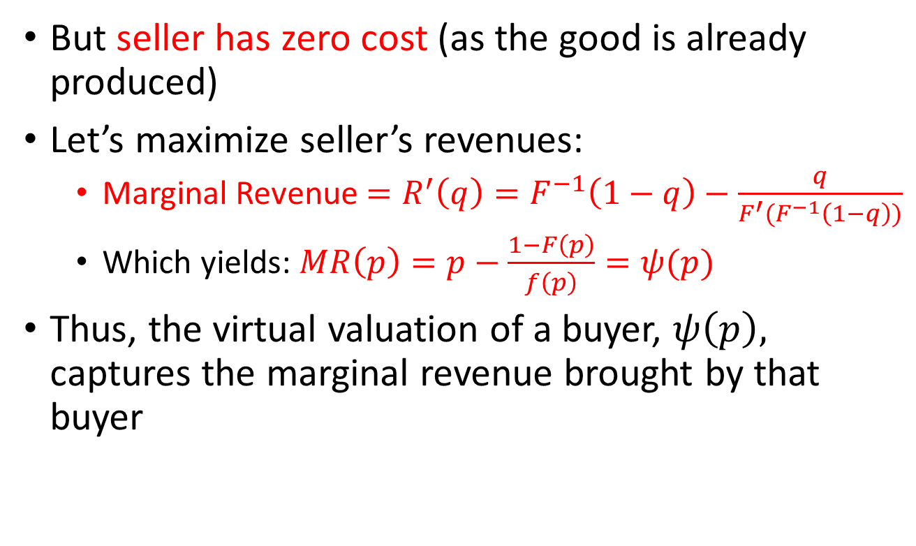
Virtual Valuation
But seller has zero cost (as the good is already produced)
Let’s maximize seller’s revenues:
  Marginal Revenue $=R^{′}\left(q\right)=F^{−1}\left(1−q\right)−\frac{q}{F^{′}(F^{−1}\left(1−q\right))}$
  Which yields: $MR\left(p\right)=p−\frac{1−F\left(p\right)}{f\left(p\right)}=ψ(p)$
Thus, the virtual valuation of a buyer, $ψ\left(p\right),$ captures the marginal revenue brought by that buyer

Slide 58
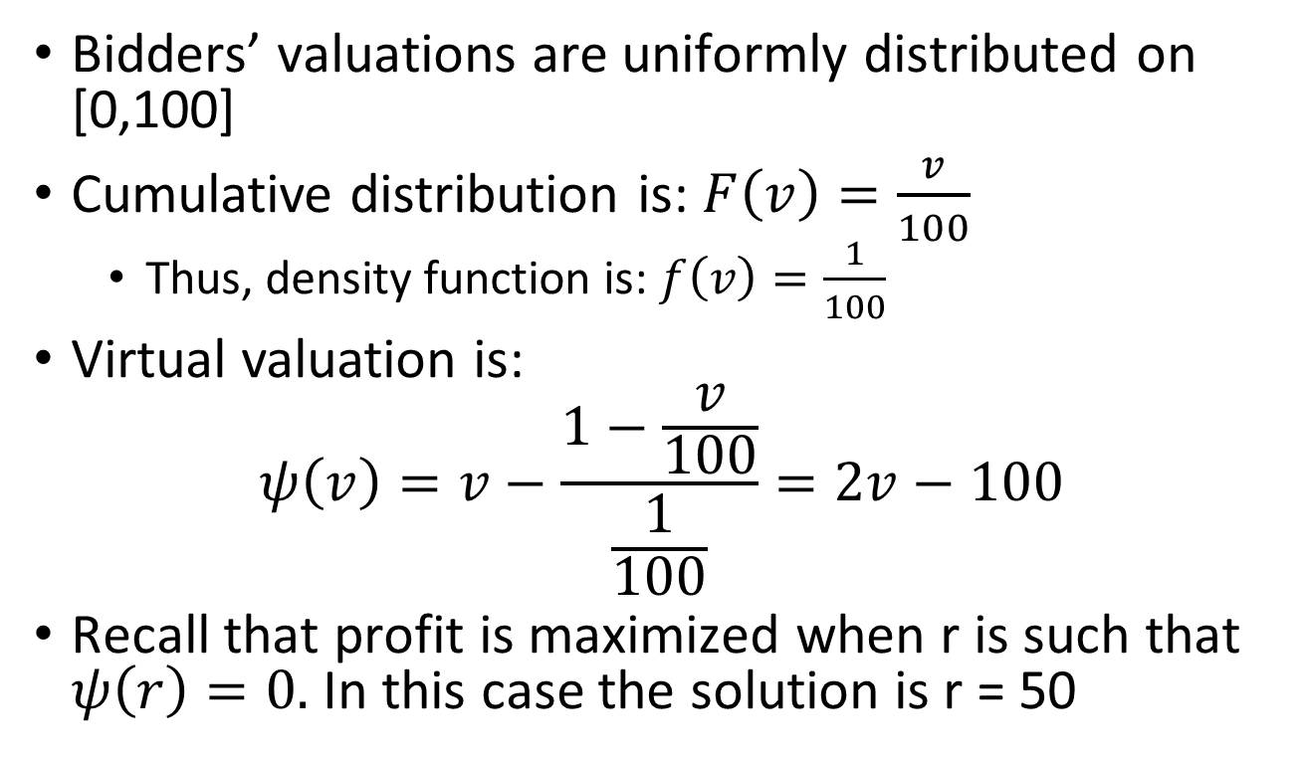
Example
Bidders’ valuations are uniformly distributed on [0,100]
Cumulative distribution is: $F\left(v\right)=\frac{v}{100}$
  Thus, density function is: $f\left(v\right)=\frac{1}{100}$
Virtual valuation is:
$$ψ\left(v\right)=v−\frac{1−\frac{v}{100}}{\frac{1}{100}}=2v−100$$
Recall that profit is maximized when r is such that $ψ\left(r\right)=0.$ In this case the solution is r = 50

Slide 59
“Perfect” reserve price is tricky…
Theorem (Bulow & Klemperer, 1996)
When valuations are private and independent, a second-price auction with n+1 bidders gives a higher expected revenue than an Optimal Mechanism with n bidders

Slide 60
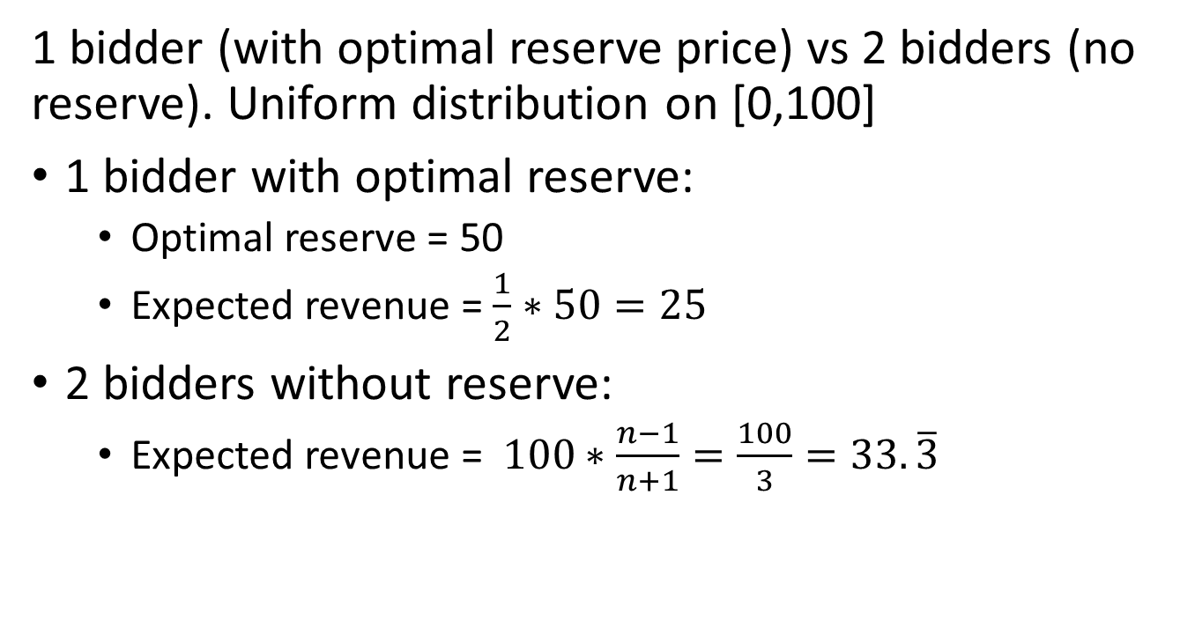
Example
1 bidder (with optimal reserve price) vs 2 bidders (no reserve). Uniform distribution on [0,100]
1 bidder with optimal reserve:
  Optimal reserve = 50
  Expected revenue = $\frac{1}{2}∗50=25$
2 bidders without reserve:
  Expected revenue = $100∗\frac{n−1}{n+1}=\frac{100}{3}=33. \overline{3}$

Slide 61
Take Away
The English and Dutch auctions are dynamic auctions: There is a ticking price (price goes up sequentially at given increases)
The Vickrey (second price) and the first-price auctions are simultaneous auctions (there is no ticking price, bidders submit sealed bids)
Truthful bidding is a dominant strategy for both the English and the Vickrey auctions
  And they yield the same outcome
Truthful bidding is not a dominant strategy for the Dutch and first-price auctions
  And they are strategically equivalent

Slide 62
Take Away
The seller’s expected revenue is the same for the English, Dutch, Vickrey, and first-price auctions
An optimal auction is an auction that maximizes the seller’s revenue. It can be done using a Vickrey auction with optimal reserve price (Myerson (1981), Riley & Samuelson (1981))
Having additional bidders and running an English auction can yield higher revenue than in an optimal auction (Bulow & Klemperer (1996))

